Slide 1
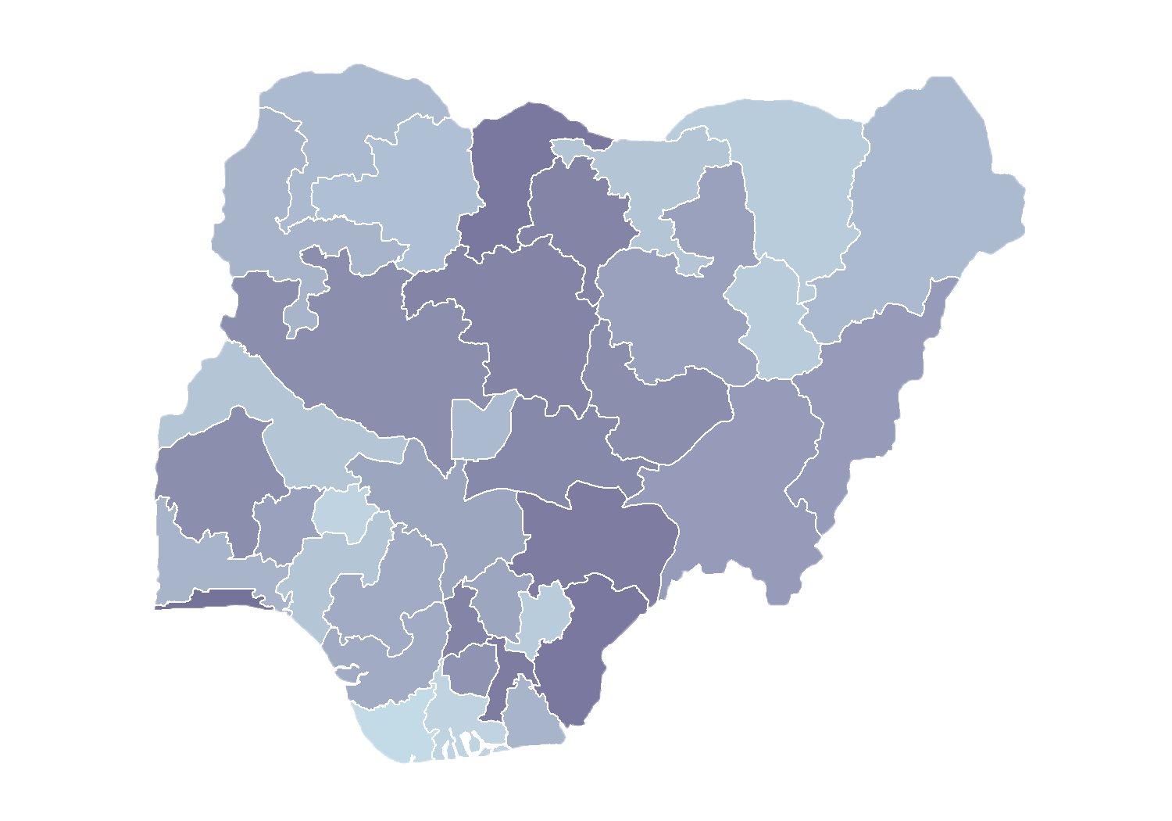
Module 1.4
Roles and User Management
Rollout of Health Facility Registry/Master Facility List for States and Local Government Areas in Nigeria
June 2019

Slide 2
Outline
Introduction
Overview of user roles
Overview of permissions
Managing users

Slide 3
Introduction
Health Facility Registries (HFRs) have been designed with role-based access control (RBAC) or a role-based security mechanism.
RBAC is a method of restricting system access based on the roles of individual users.
RBAC lets users have access rights only to what they need to do their jobs and prevents them from accessing information that doesn't pertain to them.

Slide 4
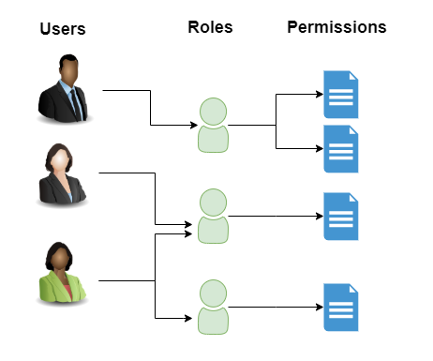
Introduction
HFR RBAC

Slide 5
Permissions
HFR permissions represent different actions that a user can perform:
View permission allows a user to view a specified module or resource.
Add permission allows a user to add data (e.g., a facility).
Edit permission allows a user to update information.
Delete permission allows a user to delete specified information.

Slide 6
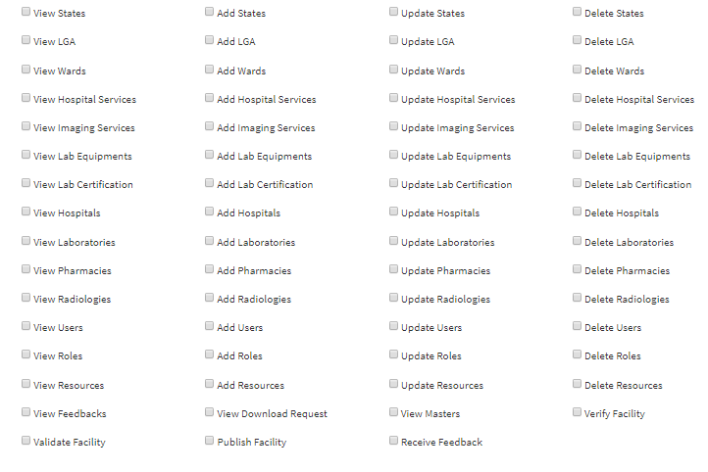
Permissions
HFR permissions

Slide 7
Roles
Roles represent user responsibilities for an HFR. For example, the Data Entry role allows a user to enter facilities in the HFR.
Roles can have multiple permissions assigned to them.
HFR roles are flexible and can be modified or defined in the front end by administrators.

Slide 8
User
management

Slide 9
Users
Users are the people given responsibilities to do things within an HFR.
HFRs have three categories of users:
Federal Ministry of Health users
State users
Local government area (LGA) users
Each user will have different responsibilities depending on their affiliation.

Slide 10
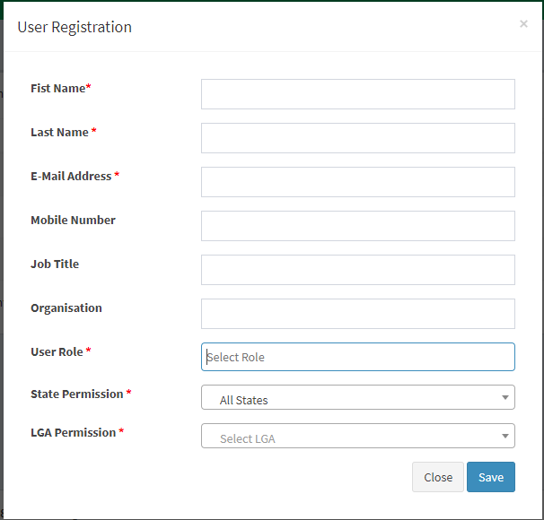
Users
Adding a user
Click on User Management -> Users.
A list of users will be displayed.
Click Register user at the top right corner.
You will then see this data entry screen.

Slide 11
Users
Adding a user
Fill out the form with user details.
Fields marked * are mandatory.
Select the permission attached to your role as a user.
LGA permission
This give the user permission to manage facilities within the assigned LGA.
State permission
This gives the user permission to manage facilities within the assigned state.
FMOH permission
This gives the user permission to manage facilities in all states.

Slide 12
Users
Updating user information
On the list of users, click Edit to the right of a given user’s name to update the entry.
Modify user information as required, then click Update.

Slide 13
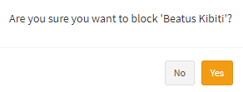
Users
Blocking a user
In an HFR, you may not delete a user, but you may block a user.
A blocked user will not be able to log in to the system.
To block a user, click Block by the name of the user on the list whom you want to block. You will get this prompt:
Click Yes to confirm.
To activate a user, follow the same procedure, clicking Active instead of Block.

Slide 14
Activity

Slide 15
Practice
Create accounts

